Slide 1





DEPARTMENT OF COMPUTER SCIENCE & ENGINEERING
Convolutional Neural Networks for Handwritten Text Conversion and post processing using NLP
Guide :
Ms.Soja Rani,
Sr.Assistant Professor,
Dept. of CSE,
NHCE, Bangalore
By :
Mohan Krishna B(1NH14CS071)
Swathi Madhavan(1NH14CS732)
Prakash H (1NH14CS167)
Rahul N (1NH14CS098)

Slide 2
Agenda
The objective is to convert the handwritten document into digital document consisting of unicode-8 characters which can be easily read or manipulated on any electronic device.

Slide 3
Contents
Abstract
Existing system
Proposed system
Algorithm/Methodology
System requirements
Timeline chart
Individual contribution
Conclusion

Slide 4
Abstract
A handwritten document page is classified into individual sentences, further into handwritten words and characters which can be converted to the digital format.
Recurrent Convolution Neural Network (RCNN) with various architectures is used to train a model that can accurately classify characters.
The characters are then passed to a Logistic Regression to obtain the probabilities using which the words can be reconstructed.
To improve efficiency, Natural Language Processing (NLP) is used to categorize words in a sentence to parts of speech.

Slide 5
Existing System
The Existing System of Handwritten text conversion uses Machine learning and Logistic Regression where a character is converted to the character with highest probability. The efficiency was later improved using convolutional neural networks.
Advantages:
Better performance in character recognition.
Disadvantages:
A character can never get a probability of 1
Post processing of the output is not implemented

Slide 6
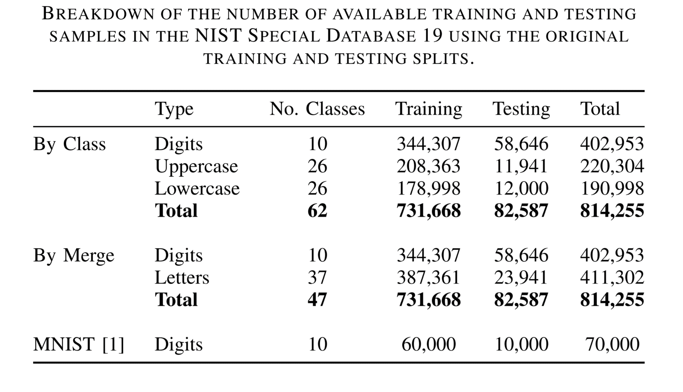
EMNIST Dataset

Slide 7
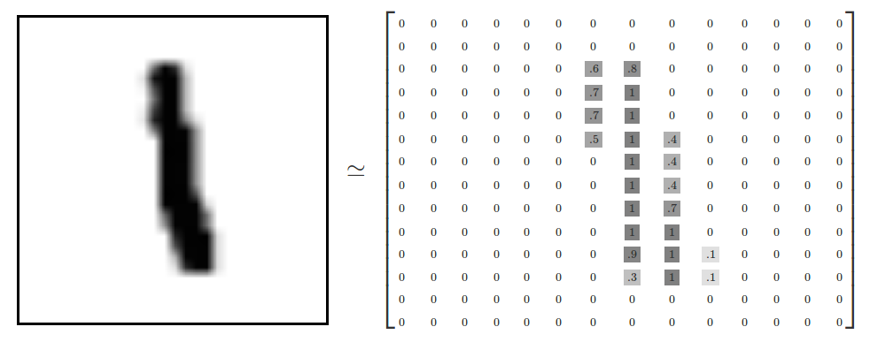
How are characters represented in the Dataset?

Slide 8
Proposed System
The Goal of Project is to improve the efficiency of conversion of a Handwritten text to digital format using RCNN(Recurrent Convolutional Neural Network) and Post processing using NLP(Natural Language Processing).
Advantages:
The word with mean probability of characters lower than the average is checked and corrected using NLP and also brute forcing it with dictionary.
NLP can also be used to identify proper nouns and not make any correction on those words.
Disadvantages:
Reduced performance due to post processing.

Slide 9
Algorithm / Methodology
Logistic Regression(Machine Learning)
Recurrent Convolutional Neural Network
Backpropagation
Natural Language Processing
POS Tagging (NLTK)

Slide 10
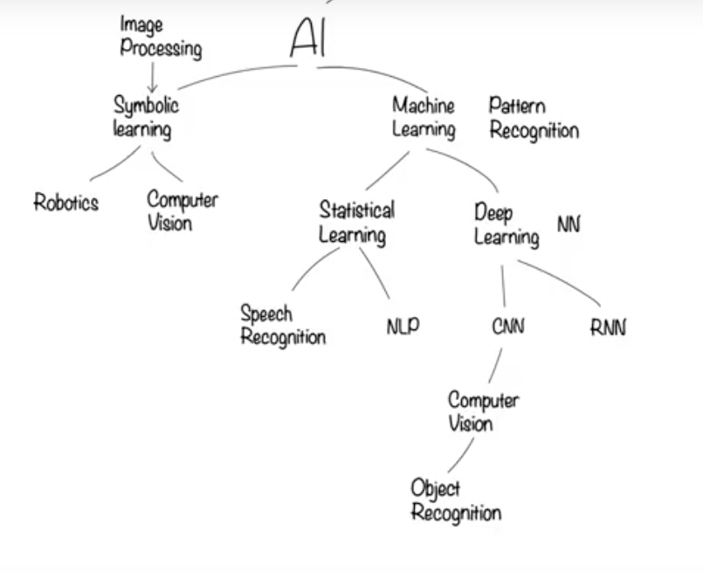

Slide 11
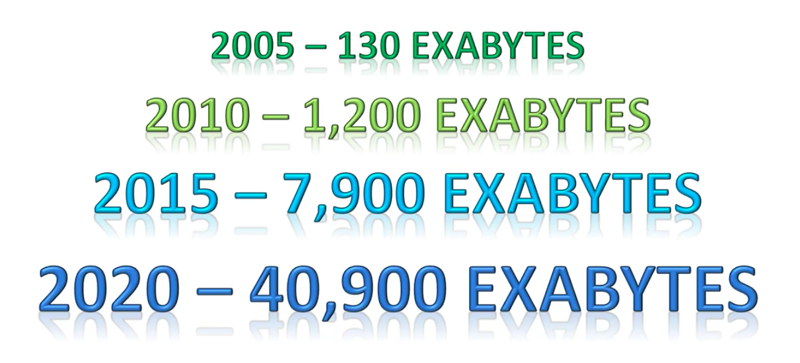
Data

Slide 12
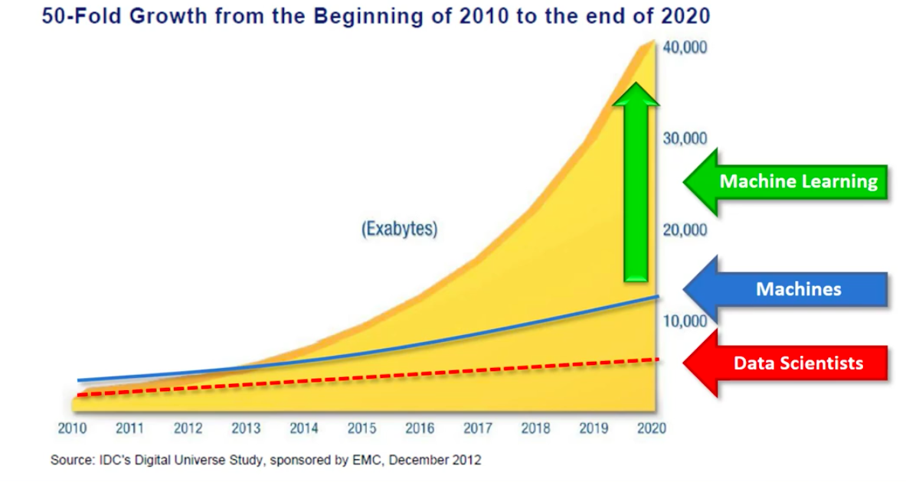
Machine Learning

Slide 13
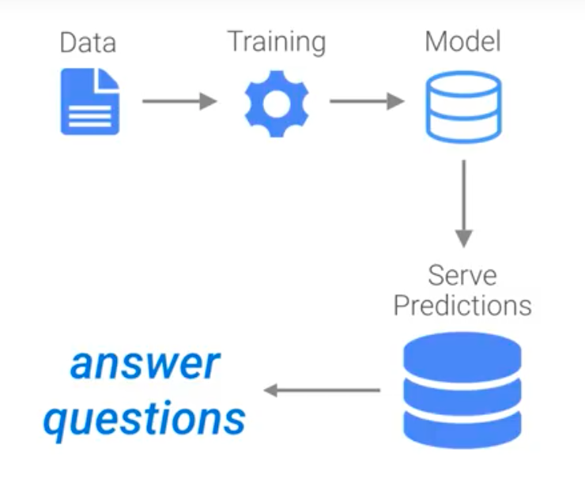
Machine Learning (continued)

Slide 14
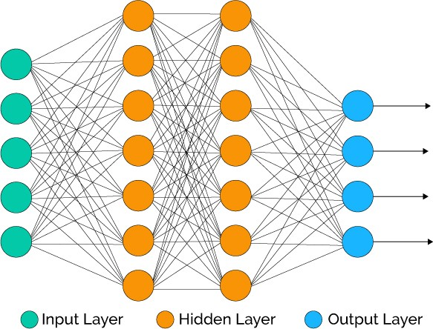
Neural Networks

Slide 15

Convolutional Neural Networks
CNN uses 3 main concepts:
Local Receptive fields
Weights and Biases
Activation and Pooling

Slide 16
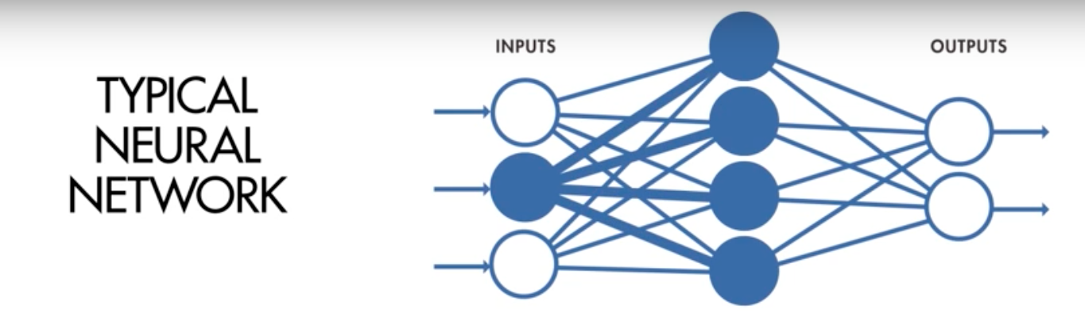
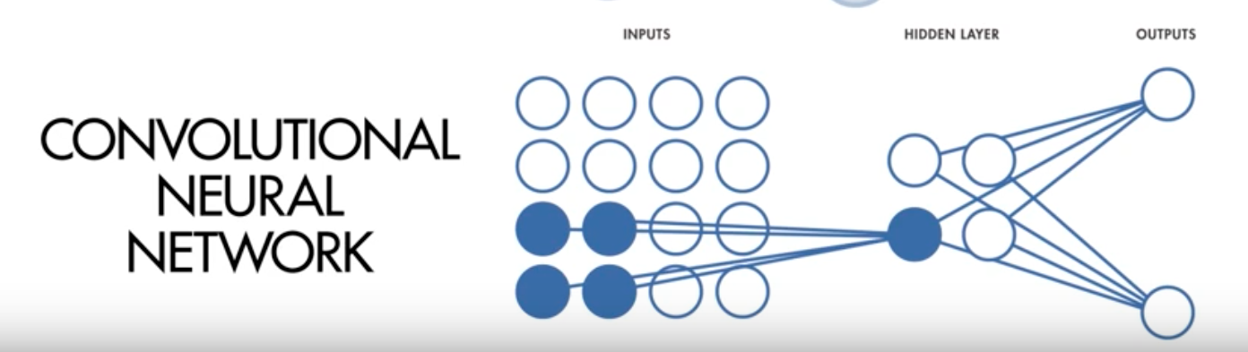

Slide 17
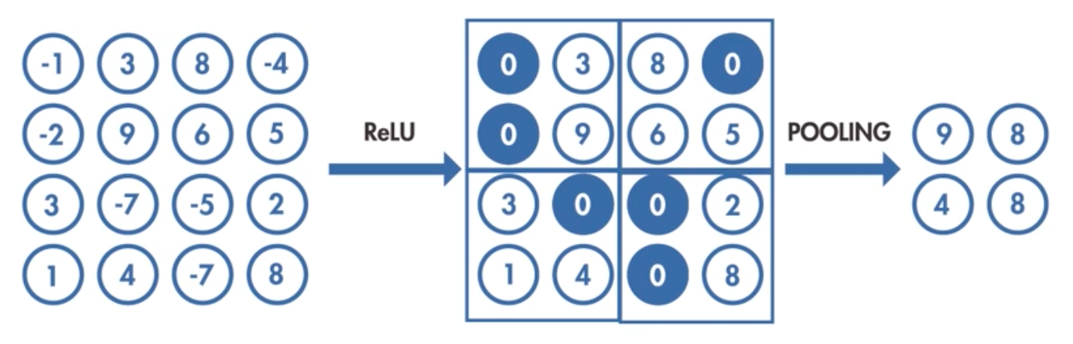

Slide 18
Softmax function
The softmax function or normalized exponential function is a generalization of the logistic function. It uses the logistic regression algorithm.
It is often used in the final layer of a CNN.
Softmax produces multiple outputs for an input array. The sum of the softmax outputs is always equal to 1.

Slide 19
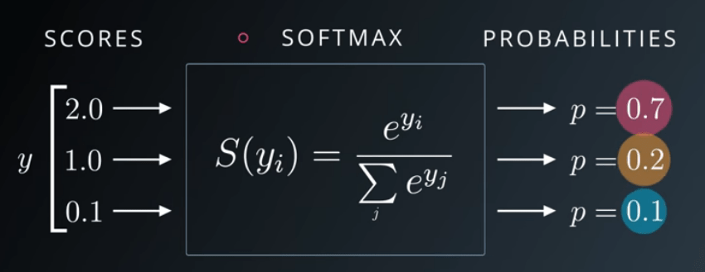
Softmax function (continued)
σ(x₁) = e^{x1} / (e^{x1}+e^{x2}+e^{x3}) = e² / (e² + e¹+ e^{0.1}) = 0.7
σ(x₂) = e^{x2} / (e^{x1}+e^{x2}+e^{x3}) = e¹ / (e² + e¹+ e^{0.1}) = 0.2
σ(x₃) = e^{x3} / (e^{x1}+e^{x2}+e^{x3}) = e^{0.1} / (e² + e¹+ e^{0.1}) = 0.1
As seen, inputs normalized between [0, 1]. Also, sum of the results are equal to 0.7 + 0.2 + 0.1 = 1.

Slide 20
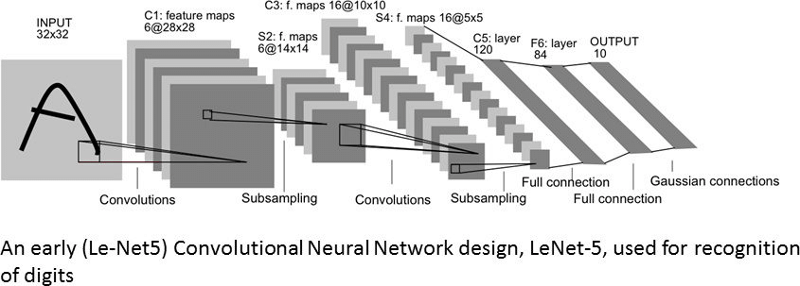
Implementation

Slide 21
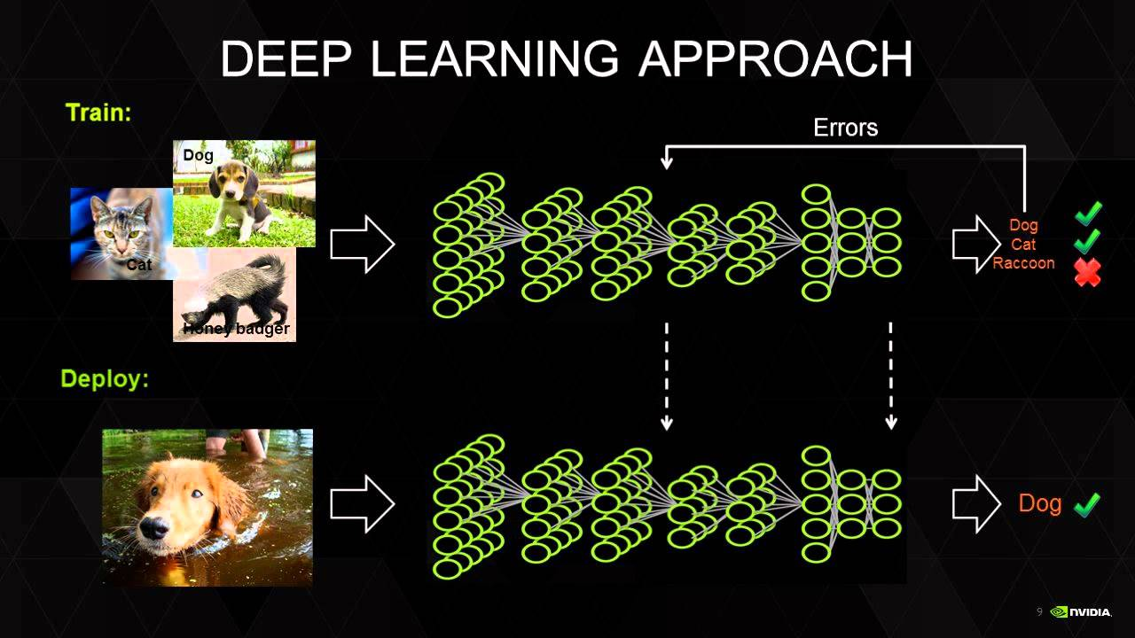
Backpropagation

Slide 22
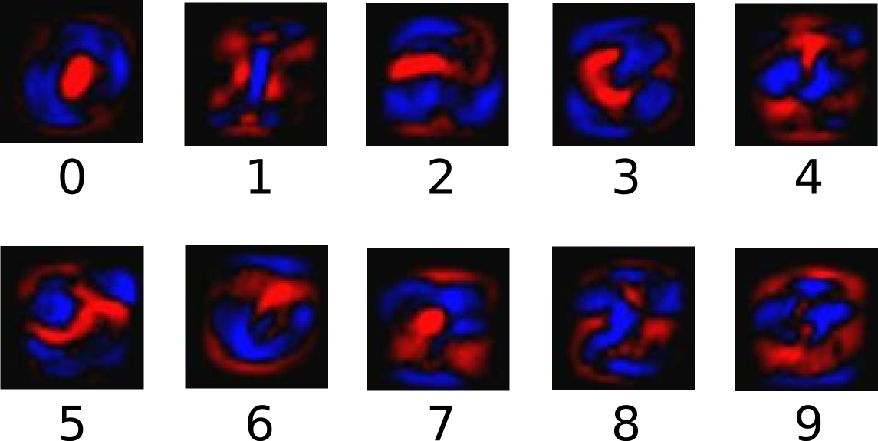
The following diagram shows the weights learnt by a model:

Slide 23
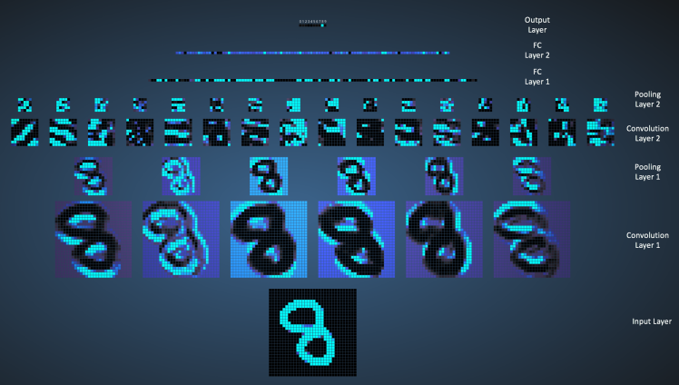

Slide 24
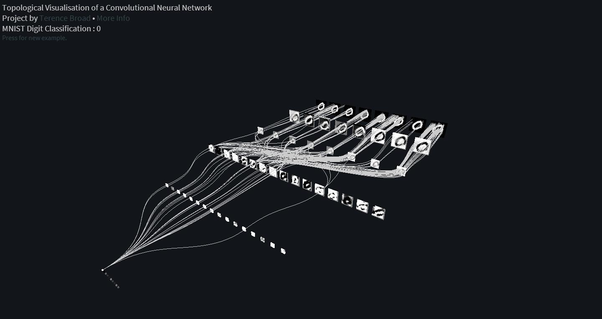

Slide 25
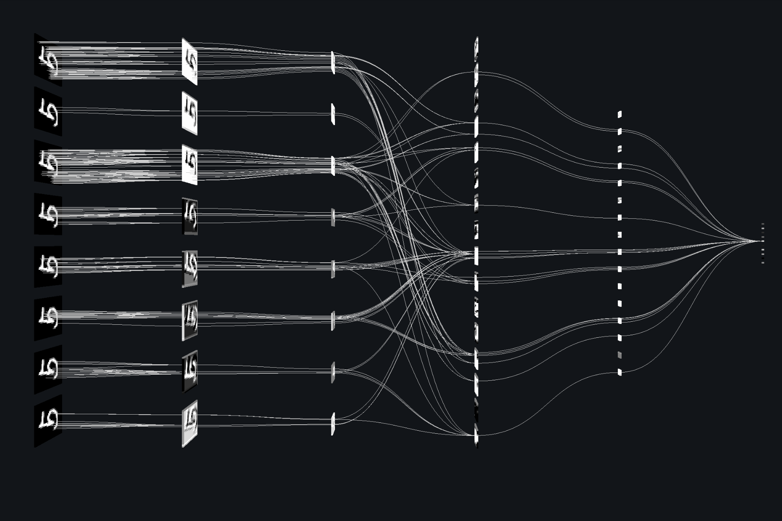

Slide 26
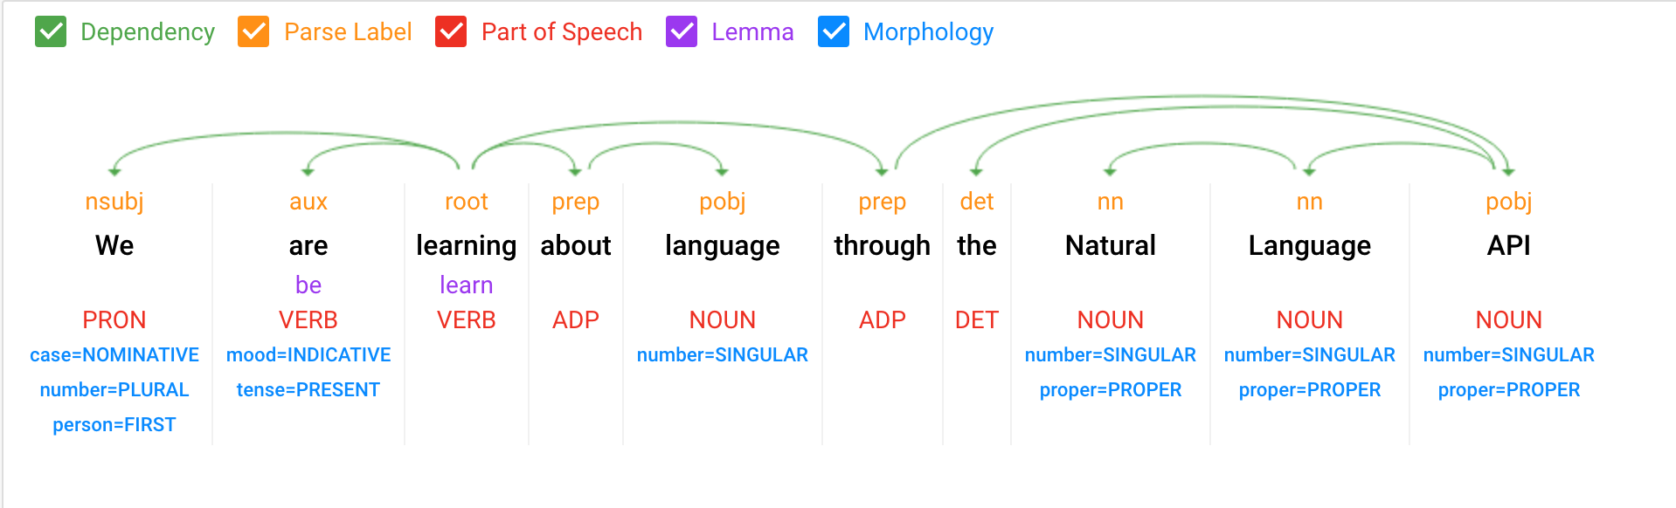
Natural Language Processing – POS Tagging

Slide 27
System Requirements
Operating System - Windows 10(preferred)
Processor - Intel i7
Speed - 3.0 GHz
RAM - 16 GB (min)
Hard Disk - 100 GB
Programming Language - Python
Graphic card NVidia with CUBA Support
Anaconda IDE
Tensor Flow
Nvidia cuDNN API
EMNIST Dataset

Slide 28
Timeline Chart

Slide 29
Individual Contribution
Name | Individual Programming Responsibility
Mohan Krishna B | Machine Learning and neural networks for creating the model
Swathi Madhavan | Natural Language processing for post processing the text conversion
Prakash H | Programming Script to input the document and classify the document into sentences, words and character segmentation.
Rahul N

Slide 30
Conclusion
In this project we will develop a Machine learning Neural Network model that can be used to convert the handwritten text document to digital document consisting of Unicode-8 characters.
The efficiency is further improved by post-processing the word into Natural Language processing model in order to make minor changes to words and sentences.

Slide 31
THANK YOU
By :
Mohan Krishna B(1NH14CS071)
Swathi Madhavan(1NH14CS732)
Prakash H (1NH14CS167)
Rahul N (1NH14CS098)

